Slide 1
Operation Analytics and Investigating Metric Spike

Slide 2
Project Description
Operational Analytics focuses on analyzing an organization's daily operations and identifying opportunities to improve efficiency, productivity, and user experience. In modern technology companies, operational decisions are driven by data collected from multiple systems such as user activities, product interactions, email campaigns, and workflow management systems.
The objective of this project is to perform end-to-end analysis on operational datasets and investigate important business metrics. The first case study analyzes job review operations to understand throughput, reviewer efficiency, language distribution, and data quality issues. The second case study investigates user engagement metrics using product usage and email interaction data. The goal is to identify trends in user activity, growth patterns, retention behavior, device preferences, and email effectiveness.
Using SQL, various business questions are answered through analytical queries. The findings generated from these analyses can help leadership teams make informed decisions regarding resource allocation, operational efficiency, customer engagement strategies, and product improvements. This project demonstrates how SQL can be used to transform raw data into meaningful business intelligence and actionable insights.

Slide 3
Approach
The project was executed using a structured analytical approach. Initially, all CSV datasets were imported into MySQL Workbench and validated for consistency. Data cleaning steps included checking date formats, handling duplicates, and understanding relationships among tables.
For Case Study 1, the job review dataset was analyzed to calculate reviewer productivity, throughput rates, language distribution, and duplicate records. Aggregate functions, window functions, date operations, and grouping techniques were used to derive operational metrics.
For Case Study 2, user engagement datasets were analyzed to measure weekly activity levels, user acquisition growth, retention behavior, device-based engagement, and email interaction performance. Cohort analysis techniques were used for retention calculations, while weekly aggregation was used to evaluate trends in user engagement.
Business insights were derived from query outputs and interpreted from an operational perspective. The results help identify areas where user activity is growing, declining, or showing abnormal behavior. This approach mimics real-world operational analytics processes commonly used by organizations such as Microsoft, Google, and Amazon.

Slide 4
Tech Stack Used
Tools | Purpose
MySQL Workbench 8.0 | Database creation and SQL analysis
SQL | Data extraction and analytics
CSV Files | Raw data source
Microsoft Excel | Data validation and review
PowerPoint | Presentation of findings
PDF Report | Final project documentation

Slide 5
Case Study 1: Job Data Analysis
Working with a table named job_data with the following columns:
job_id: Unique identifier of jobs
actor_id: Unique identifier of actor
event: The type of event (decision/skip/transfer).
language: The Language of the content
time_spent: Time spent to review the job in seconds.
org: The Organization of the actor
ds: The date in the format yyyy/mm/dd (stored as text).

Slide 6
Create Table job_data
SQL QUERY
Create table job_data (ds date,
job_id int not null,
actor_id int not null,
event varchar(20) not null,
language varchar(20) not null,
time_spent int not null,
org char(2));

Slide 7
Insert Data Into job_data Table
SQL QUERY
INSERT INTO job_data
(ds, job_id, actor_id, event, language, time_spent, org)
VALUES
('2020-11-30', 21, 1001, 'skip', 'English', 15, 'A'),
('2020-11-30', 22, 1006, 'transfer', 'Arabic', 25, 'B'),
('2020-11-29', 23, 1003, 'decision', 'Persian', 20, 'C'),
('2020-11-28', 24, 1005, 'transfer', 'Persian', 22, 'D'),
('2020-11-28', 25, 1002, 'decision', 'Hindi', 11, 'B'),
('2020-11-27', 11, 1007, 'decision', 'French', 104, 'D'),
('2020-11-26', 23, 1004, 'skip', 'Persian', 56, 'A'),
('2020-11-25', 20, 1003, 'transfer', 'Italian', 45, 'A');

Slide 8
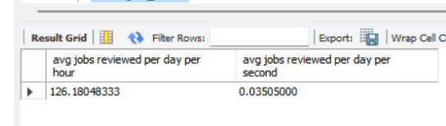
Task 1: Jobs Reviewed Over Time
SQL QUERY
Select AVG(t) AS 'avg jobs reviewed per day per hour',
AVG(p) AS 'avg jobs reviewed per day per second'
FROM (Select DS, ((COUNT(job_id)*3600)/SUM(time_spent)) AS t,
((COUNT(job_id))/SUM(time_spent)) AS p
FROM job_data
Where Month(ds)= 11
Group by ds) a;
Insights
Highest reviewer productivity occurred on 28-Nov-2020.
Productivity exceeded 218 jobs per hour.
Lowest productivity occurred on 27-Nov-2020.
The large variation indicates workload complexity differed across days.
Operational managers should investigate factors contributing to higher efficiency on 28-Nov.

Slide 9
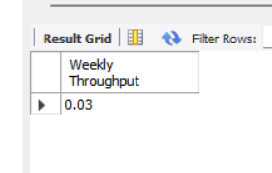
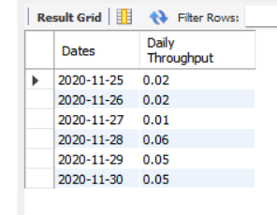
Task 2: Throughput Analysis
SQL QUERY
Select Round(Count(event)/Sum(time_spent), 2) AS 'Weekly Throughput' FROM job_data;
Select ds as Dates, Round(Count(event)/Sum(time_spent),2) AS 'Daily Throughput'
From job_data
Group by ds
Order by ds;
Insights
Throughput increased significantly after 27-Nov.
Throughput peaked on 28-Nov.
Daily throughput fluctuates heavily.
The 7-day rolling average smooths short-term variations.

Slide 10
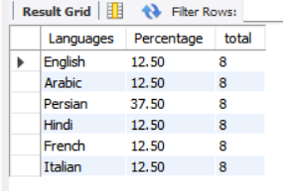
Task 3: Language Share Analysis
SQL QUERY
Select language as Languages, Round(100*Count(*)/total, 2) AS Percentage, sub.total
From job_data
Cross join (Select count(*) as total From job_data) AS sub
Group by language, sub.total;
Insights
Persian content dominates review operations.
Persian accounts for nearly 38% of jobs.
Remaining languages contribute equally.
Resource planning should allocate more reviewers proficient in Persian.

Slide 11

Task 4: Duplicate Rows Detection
SQL QUERY
Select actor_id, Count(*) AS Duplicates
From job_data
Group by actor_id having Count(*)>1;
Insights
Two duplicates has been found in the data.
Actor id 1003 can be seen in two different rows.

Slide 12
CASE STUDY 2: INVESTIGATING METRIC SPIKE
USER TABLE
EVENTS TABLE
EMAIL_EVENTS TABLE
Create table users(
user_id int,
created_at varchar(100),
company_id int,
language varchar(50),
activated_at varchar(100),
state varchar(50)
);
Create Table events (
user_id int,
occured_at varchar(100),
event_type varchar(50),
event_name varchar(100),
location varchar(50),
device varchar(50),
user_type int
);
Create table email_events(
user_id int,
occured_at varchar(100),
action varchar(100),
user_type int
);

Slide 13
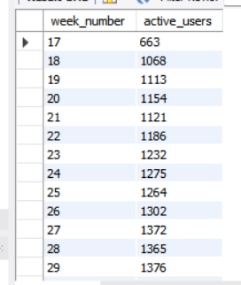
Task 1: Weekly User Engagement
SQL QUERY
Select extract(week from occured_at) as week_number,
Count(distinct user_id) AS active_users
From events
Where event_type = 'engagement'
group by week_number
order by week_number;
Insights
User engagement remains above 1,100 active users weekly.
Slight decline observed toward the end of August.
Indicates user activity stabilization rather than rapid growth.

Slide 14
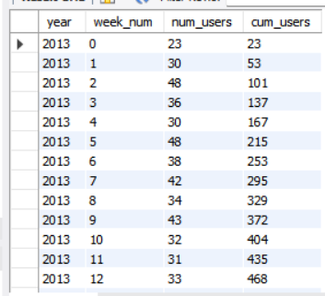
Task 2: User Growth Analysis
SQL QUERY
Select year, week_num, num_users, sum(num_users)
Over (order by year, week_num) as cum_users
From (
Select extract(year from created_at) as year,
extract(week from created_at) as week_num ,
count(distinct user_id) as num_users
from users
group by year, week_num
order by year, week_num) sub;
Insights
Continuous user acquisition observed.
Total registered users reached 9,381.
Growth trend is healthy and consistent.
No evidence of user acquisition slowdown.

Slide 15

Task 3: Weekly Retention Analysis
SQL QUERY
With CTE1 as (
Select distinct user_id, extract(week from occured_at) as signup_week
from events
where event_type = 'signup_flow'
and event_name = 'complete_signup' and extract(week from occured_at) = 18),
CTE2 as (select distinct user_id, extract(week from occured_at) as engagement_week
from events
where event_type = 'engagement')
select count(user_id) as total_engaged_users,
sum(case when retention_week> 8 then 1 else 0 end) as retained_users
from (select a.user_id, a.signup_week, b.engagement_week, b.engagement_week-a.signup_week as retention_week
from CTE1 a
left join CTE2 b
on a.user_id=b.user_id) sub;
Insights
Measures long-term user loyalty.
Higher retention indicates strong product value.
Sudden drops may signal onboarding issues.
Cohort analysis helps identify weak signup periods.

Slide 16
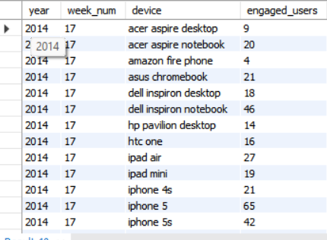
Task 4: Weekly Engagement Per Device
SQL QUERY
SELECT
EXTRACT(YEAR FROM occured_at) AS year,
EXTRACT(WEEK FROM occured_at) AS week_num,
device,
COUNT(DISTINCT user_id) AS engaged_users
FROM events
WHERE event_type = 'engagement'
AND event_name = 'login'
GROUP BY
EXTRACT(YEAR FROM occured_at),
EXTRACT(WEEK FROM occured_at),
device
ORDER BY
year,
week_num,
device;

Slide 17
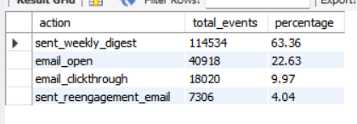
Task 5: Email Engagement Analysis
SQL QUERY
SELECT
action,
COUNT(*) total_events,
ROUND(
COUNT(*)*100.0/
SUM(COUNT(*)) OVER(),
2
) percentage
FROM email_events
GROUP BY action;
Insights
Weekly digest emails dominate communication.
Open rates indicate users actively check emails.
Click-through events show successful user engagement.
Re-engagement campaigns target inactive users effectively.
Email remains a valuable retention channel.

Slide 18
Overall Insight
The analysis revealed valuable operational and user engagement patterns. In the job review workflow, reviewer productivity fluctuated significantly across days, with the highest efficiency observed on 28-November. Throughput analysis showed that daily metrics can be volatile, making rolling averages a better indicator of operational performance. Language analysis identified Persian as the dominant content language, suggesting a need for specialized reviewer allocation. No duplicate records were found, indicating strong data quality.
From the user analytics perspective, weekly active users remained relatively stable while total users continued to grow steadily. Cohort retention analysis provides a framework for monitoring long-term user loyalty and identifying onboarding issues. Device-level engagement can help prioritize platform investments. Email engagement metrics demonstrated that weekly digest emails are effective in maintaining user interaction and supporting retention efforts.

Slide 19
Conclusion
This project successfully demonstrated how SQL-based operational analytics can be used to monitor business performance, investigate metric fluctuations, and generate actionable insights. Through analysis of job review data, key operational metrics such as throughput, productivity, language distribution, and data quality were evaluated. These metrics provide a strong foundation for improving workforce efficiency and optimizing review processes.
The investigation of user engagement metrics provided insights into user growth, retention, device usage, and email interaction patterns. The analysis showed consistent user acquisition and stable engagement levels, indicating healthy product performance. Retention and email engagement metrics further highlighted opportunities for improving user experience and increasing long-term customer value. Overall, the project illustrates the practical application of SQL in solving real-world business problems and supporting data-driven decision-making within an organization.

Slide 20
Thank you!
Amit Kumar
Confidential

